Slide 1
Capacity and Facility Location and Analysis

Slide 2
Capacity
Maximum capability to produce
Capacity planning
  Establishes overall level of productive resources for a firm
3 basic strategies for timing of capacity expansion for steady growth in demand

Slide 3
Capacity Strategies
Leading
  Build capacity in anticipation of future demand increases
Following
  Build capacity when demand exceeds current capacity
Tracking
  Similar to the following strategy, but adds capacity in relatively small increments to keep pace with increasing demand

Slide 4
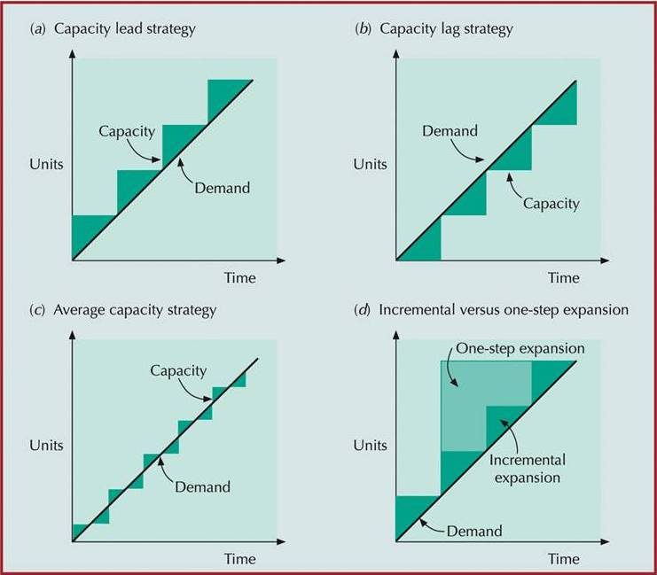
Capacity Expansion Strategies

Slide 5
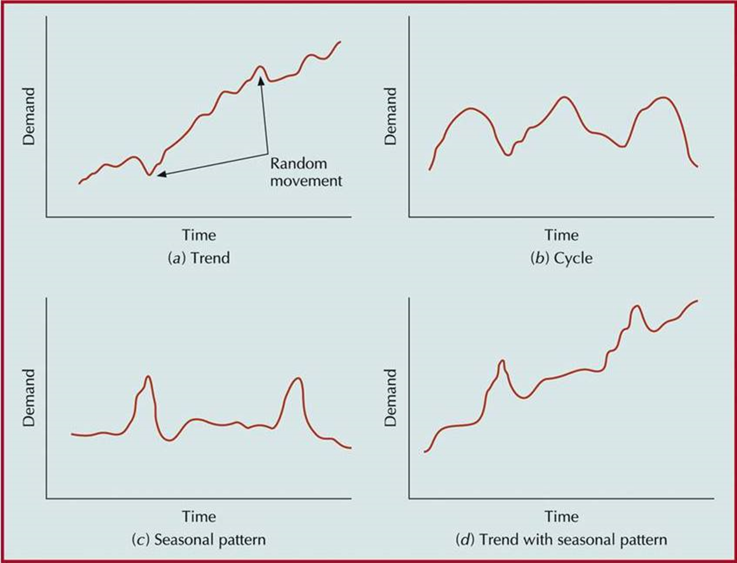
Forecast and Capacity

Slide 6
Capacity (cont.)
Capacity increase depends on
  Expected Volume
  Demand certainty
  Strategic objectives
  Costs of expansion and operation
Best operating level
  % of capacity utilization that minimizes unit costs
  Achieves economy of scale
Capacity cushion
  % of capacity held in reserve for unexpected occurrences

Slide 7
Capacity Decisions Are Strategic
Capacity decisions
  impact the ability of the organization to meet future demands
  affect operating costs
  are a major determinant of initial cost
  often involve long-term commitment of resources
  can affect competitiveness
  affect the ease of management
  have become more important and complex due to globalization
  need to be planned for in advance due to their consumption of financial and other resources

Slide 8
How it works
Forecast
Process
Capacity and Facility
Product/Service

Slide 9
Defining and Measuring Capacity
Measure capacity in units that do not require updating
  Why is measuring capacity in dollars problematic?
Two useful definitions of capacity
  Design capacity
    The maximum output rate or service capacity an operation, process, or facility is designed for
  Effective capacity
    Design capacity minus allowances such as personal time and maintenance

Slide 10
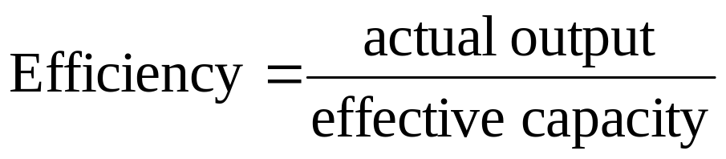
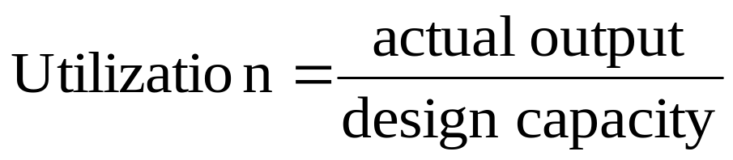
Measuring System Effectiveness
Actual output
  The rate of output actually achieved
  It cannot exceed effective capacity
Efficiency
Utilization
    Measured as percentages

Slide 11
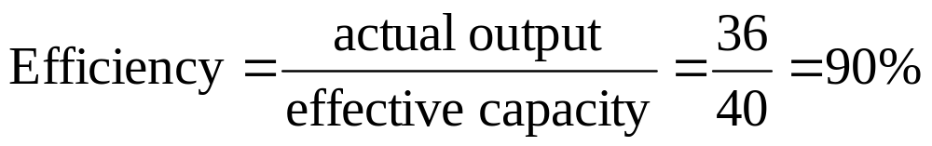
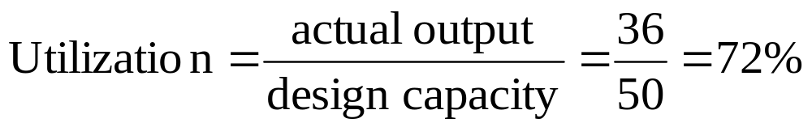
Example – Efficiency and Utilization
Design Capacity = 50 trucks per day
Effective Capacity = 40 trucks per day
Actual Output = 36 trucks per day

Slide 12
Determinants of Effective Capacity
Facilities
Product and service factors
Process factors
Human factors
Policy factors
Operational factors
Supply chain factors
External factors

Slide 13
Economies of Scale
Costs less per unit to produce more
  Fixed costs can be spread over a larger number of units
  Production or operating costs do not increase linearly with output levels
  Quantity discounts are available for material purchases
  Operating efficiency increases as workers gain experience

Slide 14
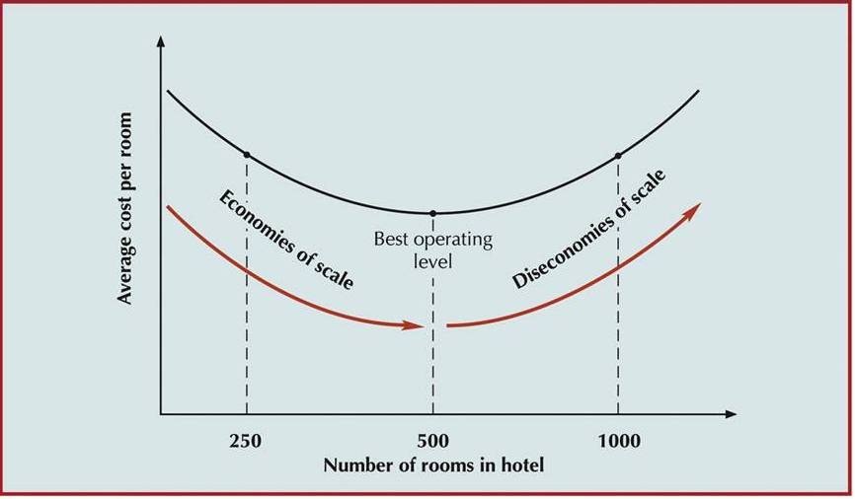
Best Operating Level for a Hotel

Slide 15
Optimal Operating Level
Average cost per unit
Minimum
cost
Optimal
Output
Rate
Rate of output

Slide 16
Economies and Diseconomies of Scale
Economies of Scale
  If output rate is less than the optimal level, increasing the output rate results in decreasing average per unit costs
Diseconomies of Scale
  If the output rate is more than the optimal level, increasing the output rate results in increasing average per unit costs

Slide 17
Economies of Scale
Economies of Scale
  If output rate is less than the optimal level, increasing the output rate results in decreasing average per unit costs
  Reasons for economies of scale:
    Fixed costs are spread over a larger number of units
    Construction costs increase at a decreasing rate as facility size increases
    Processing costs decrease due to standardization

Slide 18
Diseconomies of Scale
Diseconomies of Scale
  If the output rate is more than the optimal level, increasing the output rate results in increasing average per unit costs
  Reasons for diseconomies of scale
    Distribution costs increase due to traffic congestion and shipping from a centralized facility rather than multiple smaller facilities
    Complexity increases costs
    Inflexibility can be an issue
    Additional levels of bureaucracy

Slide 19
Facility Size and Optimal Operating Level
Minimum cost & optimal operating rate are
functions of size of production unit.
Average cost per unit
Small
plant
Medium
plant
Large
plant
Output rate

Slide 20
Capacity Cushion
Capacity Cushion
  Extra capacity used to offset demand uncertainty
  Capacity cushion = 100% - Utilization
  Capacity cushion strategy
    Organizations that have greater demand uncertainty typically have greater capacity cushion
    Organizations that have standard products and services generally have smaller capacity cushion

Slide 21
Service Capacity Planning
Service capacity planning can present a number of challenges related to:
  The need to be near customers
    Convenience
  The inability to store services
    Cannot store services for consumption later
  The degree of demand volatility
    Volume and timing of demand
    Time required to service individual customers

Slide 22
Demand Management Strategies
Strategies used to offset capacity limitations and that are intended to achieve a closer match between supply and demand
  Pricing
  Promotions
  Discounts
  Other tactics to shift demand from peak periods into slow periods

Slide 23
In-House or Outsource?
Once capacity requirements are determined, the organization must decide whether to produce a good or service itself or outsource
Factors to consider:
  Available capacity
  Expertise
  Quality considerations
  The nature of demand
  Cost
  Risks

Slide 24
Outsourcing a process
Cost
Capacity
Quality
Speed
Reliability
Expertise

Slide 25
Outsourcing + Off Shoring
Out sourcing
On Shoring
or
Near shoring
Off Shoring
In house
?
?
?
?

Slide 26
Developing Capacity Alternatives
Things that can be done to enhance capacity management:
  Design flexibility into systems
  Take stage of life cycle into account
  Take a “big-picture” approach to capacity changes
  Prepare to deal with capacity “chunks”
  Attempt to smooth capacity requirements
  Identify the optimal operating level
  Choose a strategy if expansion is involved

Slide 27
The Need for Location Decisions
Location decisions arise for a variety of reasons:
  Addition of new facilities
    As part of a marketing strategy to expand markets
    Growth in demand that cannot be satisfied by expanding existing facilities
  Depletion of basic inputs requires relocation
  Shift in markets
  Cost of doing business at a particular location makes relocation attractive

Slide 28
Location Decisions:
Strategically Important
Location decisions:
  Are closely tied to an organization’s strategies
    Low-cost
    Convenience to attract market share
  Effect capacity and flexibility
  Represent a long-term commitment of resources
  Effect investment requirements, operating costs, revenues, and operations
  Impact competitive advantage
  Importance to supply chains

Slide 29
Location Decisions: Objectives
Location decisions are based on:
  Profit potential or cost and customer service
  Finding a number of acceptable locations from which to choose
  Position in the supply chain
    End: accessibility, consumer demographics, traffic patterns, and local customs are important
    Middle: locate near suppliers or markets
    Beginning: locate near the source of raw materials
  Web-based retail organizations are effectively location independent

Slide 30
Supply Chain Considerations
Supply chain management must address supply chain configuration:
  Number and location of suppliers, production facilities, warehouses and distribution centers
  Centralized vs. decentralized distribution
The importance of such decisions is underscored by their reflection of the basic strategy for accessing customer markets

Slide 31

Global Location: Benefits
A wide range of benefits have accrued to organizations that have globalized operations:
  Markets
  Cost savings
  Legal and regulatory
  Financial
  Other

Slide 32

Global Location: Disadvantages
There are a number of disadvantages that may arise when locating globally:
  Transportation costs
  Security costs
  Unskilled labor
  Import restrictions
  Criticism for locating out-of-country

Slide 33

Global Location: Risks
Organizations locating globally should be aware of potential risk factors related to:
  Political instability and unrest
  Terrorism
  Economic instability
  Legal regulation
  Ethical considerations
  Cultural differences

Slide 34
Managing Global Operations
Managerial implications for global operations:
  Language and cultural differences
    Risk of miscommunication
    Development of trust
    Different management styles
    Corruption and bribery
  Increased travel (and related) costs
  Challenges associated with managing far-flung operations
  Level of technology and resistance to technological change
  Domestic personnel may resist locating, even temporarily

Slide 35
Types of Facilities
Heavy-manufacturing facilities
  Large, require a lot of space, and are expensive
Light-industry facilities
  Smaller, cleaner plants and usually less costly
Retail and service facilities
  Smallest and least costly

Slide 36
Factors in Heavy Manufacturing Location
Construction costs
Land costs
Shipment modes
Labor availability
Proximity to materials
Utilities
Means of waste disposal

Slide 37
Factors in Light Industry Location
Land costs
Transportation costs
Proximity to markets
  Depends on frequency of delivery required by customer

Slide 38
Service and Retail Locations
Considerations:
  Nearness to raw materials is not usually a consideration
  Customer access is a
    Prime consideration for some: restaurants, hotels, etc.
    Not an important consideration for others: service call centers, etc.
  Tend to be profit or revenue driven, and so are
    Concerned with demographics, competition, traffic volume patterns, and convenience
  Clustering
    Similar types of businesses locate near one another

Slide 39
Factors in Retail Location
Proximity to customers
Location, Location, Location
Lots of parking (suburban feature)
Proximity to Competition

Slide 40
More examples
Dept. and Grocery Stores
Food service and Restaurants

Slide 41
Where to Locate?
Very important
  being “in the right place at the right time”
Financial considerations, lease terms
Location decisions made more often for service operations than manufacturing facilities
Location criteria for service
  access to customers

Slide 42
Going global? Location Factors
Government stability
Economic systems and Exchange rates
Climate
Export/import regulations,
duties and tariffs

Slide 43
Location Factors
Incentive packages and Taxes
Government & Environmental regulations
  Energy availability and cost
Quality of life
Availability of sites

Slide 44
Location Incentives
Proximity of customers
Construction, leasing costs, land cost
Raw material availability

Slide 45
Govt. Incentives
Tax credits and subsidies
Government regulation and incentives
Job training
Infrastructure improvement

Slide 46
Corporate Considerations
Proximity of suppliers
Transportation and distribution system
Labor availability, cost and education
Available technology
Trade agreements

Slide 47

Location: Options
Existing companies generally have four options available in location planning:
  Expand an existing facility
  Add new locations while retaining existing facilities
  Shut down one location and move to another
  Do nothing

Slide 48
Junior’s Reasons to move
At least once a week, 40,000 pounds of cream cheese is delivered to their bay doors.
The 103,000-square-foot building will replace a much smaller one in Maspeth, Queens, that has housed Junior’s main baking operation for 15 years.
The scale of the facility, broken into three sections, is five times the size of their previous production area and has allowed the 65-year-old company to expand rapidly.
The extra space and efficient layout gives his 75 employees the ability to churn out at least 10,000 cakes on an average day, and their storage capacity has allowed them to bypass outside vendors and more closely control their own supply of ingredients.
The building had been the home base for Mother’s Kitchen, which made cheesecakes there for Rich Products Corporation, a food-service company in Buffalo. Mother’s Kitchen moved last year to Missouri City, Tex.

Slide 49
UA’s reasons to move
Under Armour already has a small office in Portland, where it is hoping to tap into the network of footwear designers and engineers here as it plans to double its revenues by 2018 to $7.5 billion.
“As Under Armour continues its global expansion, Portland has emerged as a strategic hub for the brand, specifically in footwear and innovation,” said spokeswoman Diane Pelkey.

Slide 50
Layouts for better service and higher productivity

Slide 51
Objectives of a Good Facility Layout
Minimize movement
Utilize space efficiently
Utilize labor efficiently
Eliminate bottlenecks

Slide 52
Objectives of a Good Facility Layout
Increase communication and interaction with customers
Reduce service time
Eliminate redundant movement
Increase available capacity

Slide 53
Objectives of a Good Facility Layout
Facilitate easy entry, exit and placement of
  material
  products
  people
Incorporate safety and security measures
(ex. theft prevention at electronics store)

Slide 54
Objectives of a Good Facility Layout
Promote product and service quality
Facilitate maintenance
Provide a visual control of activities
Provide flexibility to adapt to changing conditions

Slide 55
Basic Layout
Process layouts
  group similar activities together according to process or function they perform
Product layouts
  arrange activities in line according to sequence of operations
Fixed-position layouts
  are used for projects in which product cannot be moved

Slide 56
Process Layout in Services
Store layouts
Coffee shop layouts
Fast Food layouts
Library layout
Bank layout
Cafeteria Layout

Slide 57
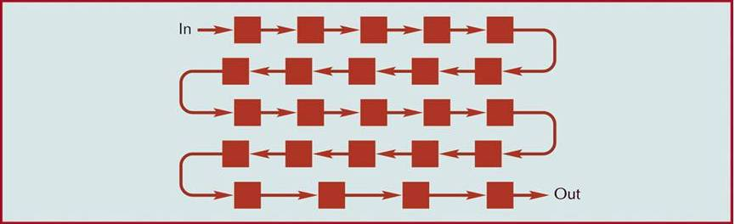
A Product Layout

Slide 58
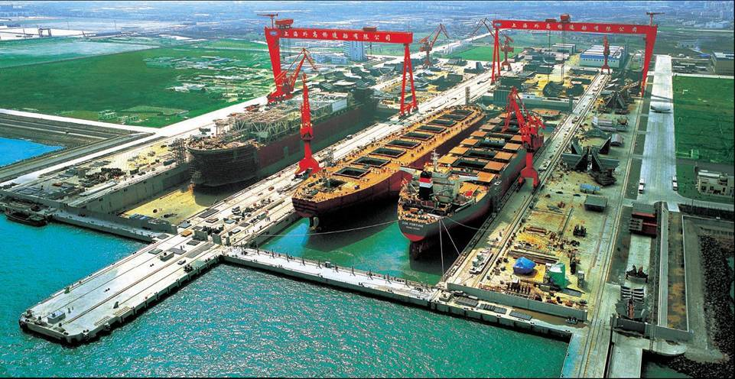
Fixed-Position Layouts
Too fragile, bulky, or heavy to move
Equipment, workers, materials brought to the site
Low equipment utilization
Highly skilled labour
High variable costs

Slide 59
Designing Service Layouts
Must be attractive and functional
Types
  Free flow layouts
    encourage browsing,
    increase impulse purchasing,
    are flexible and visually appealing

Slide 60
Designing Service Layouts
Grid layouts
  encourage customer familiarity,
  are low cost,
  easy to clean and secure,
  good for repeat customers
Loop and Spine layouts
  both increase customer sightlines and exposure to products,
  encouraging customer to circulate through the entire store

Slide 61
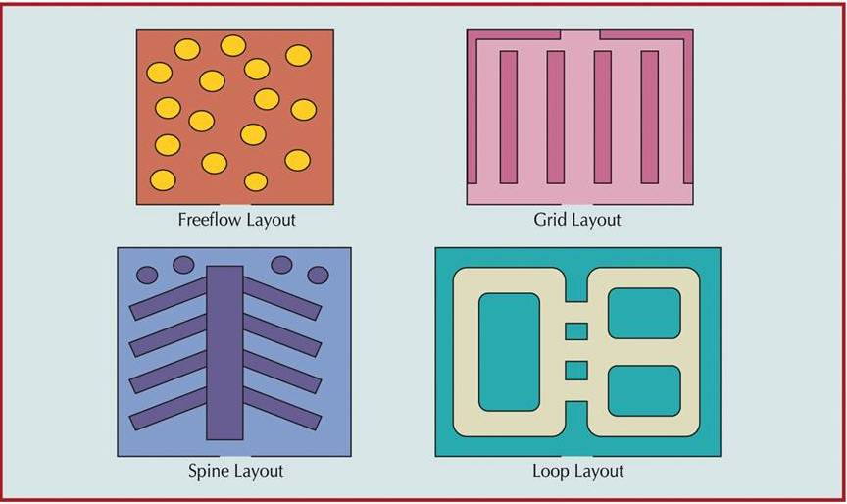
Types of Store Layouts

Slide 62
Hybrid Layouts
Cellular layouts
  Process families or product families
  Group similar services or activities
Flexible manufacturing system
  Systems which can produce/process a variety of items
Mixed-model assembly line
  processes more than one model in one line

Slide 63
Cellular Layouts
Identify families of parts/service with similar flow paths
Group activities into cells based on families
Arrange cells so movement is minimized within a cell

